Slide 1
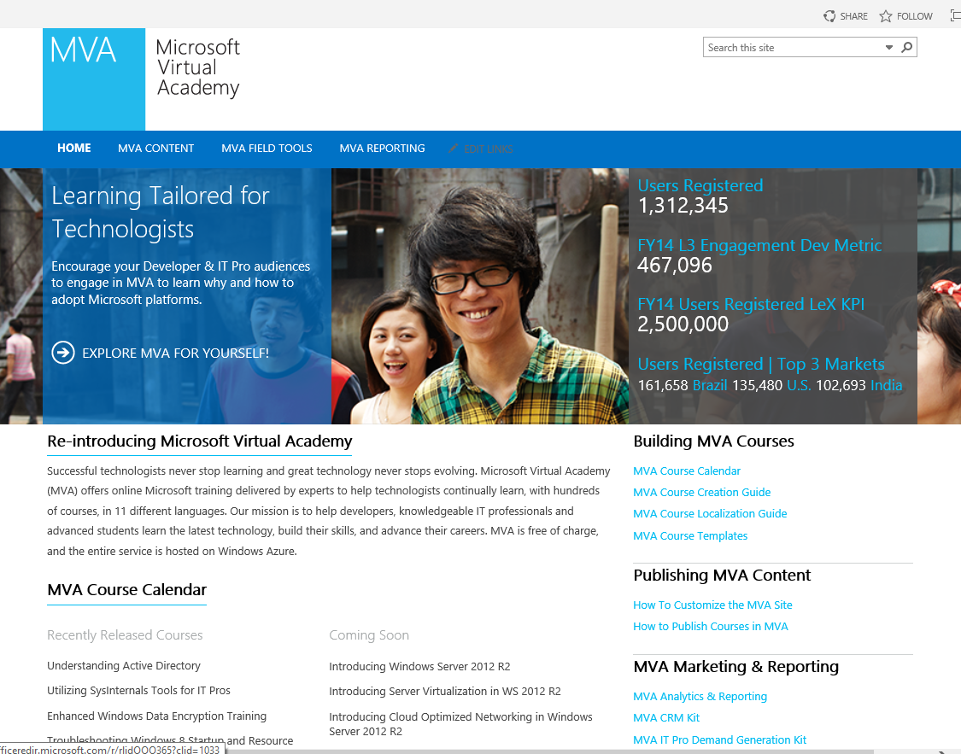
Microsoft Virtual Academy Design
The Challenge
Microsoft Virtual Academy came to Affirma to build a custom solution that would combine various sites and document pages into one easy to use platform. MVA wanted us to set the homepage up in a way that was easy to use and relevant for its various user types, with interactive components that would change based on content offerings and could easily be accessed and modified internally.
What We Did
<ul>
<li>Affirma implemented dynamic capabilities in SharePoint 2013 to deliver a fully functioning site with a searchable content page.</li>
<li>We constructed a custom search tool based on the client’s needs, and tailored it so that they were able to update the fields and search criteria on the backend.</li>
<li>We worked closely with them to design a course calendar that was easily utilized by site users and updated each term.</li>
</ul>
Results
Affirma drew on our expertise in SharePoint technology and architected a dynamic site. The project was deployed successfully. We created a site with administrative access which allowed the client to easily modify their search criteria. We then saw it through implementation, went live, and received very good feedback. MVA was highly satisfied with the end results, and we are looking forward on planning the next phase.

